Slide 1
Keys, Constraints
System Design(SD)(22CS024)
Bachelor of Engineering- Computer Science & Engineering
Department of Computer Science & Engineering
Chitkara University Institute of Engineering and Technology, Chitkara University, Punjab, India

Slide 2
KEYS
Keys are fundamental components that ensure data integrity, uniqueness and efficient access. It is widely used to identify the tuples(rows) uniquely in the table.
We also use keys to set up relations amongst various columns and tables of a relational database.

Slide 3
Why do we require Keys in a DBMS?
Keys are important in a Database Management System (DBMS) for several reasons:
Uniqueness: Keys ensure that each record in a table is unique and can be identified distinctly.
Data Integrity: Keys prevent data duplication and maintain the consistency of the data.
Efficient Data Retrieval: By defining relationships between tables, keys enable faster querying and better data organization. Without keys, it would be extremely difficult to manage large datasets and queries would become inefficient and prone to errors.

Slide 4
1. Super Key
The set of one or more attributes (columns) that can uniquely identify a tuple (record) is known as SUPER KEY. It may include extra attributes that aren't important for uniqueness but still uniquely identify the row. For Example, STUD_NO, (STUD_NO, STUD_NAME), etc.
A super key is a group of single or multiple keys that uniquely identifies rows in a table. It supports NULL values in rows.
A super key can contain extra attributes that aren’t necessary for uniqueness.
For example, if the "STUD_NO" column can uniquely identify a student, adding "SNAME" to it will still form a valid super key, though it's unnecessary.

Slide 5
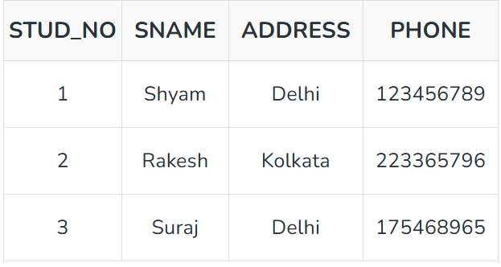
Example: Consider the STUDENT table.

Slide 6
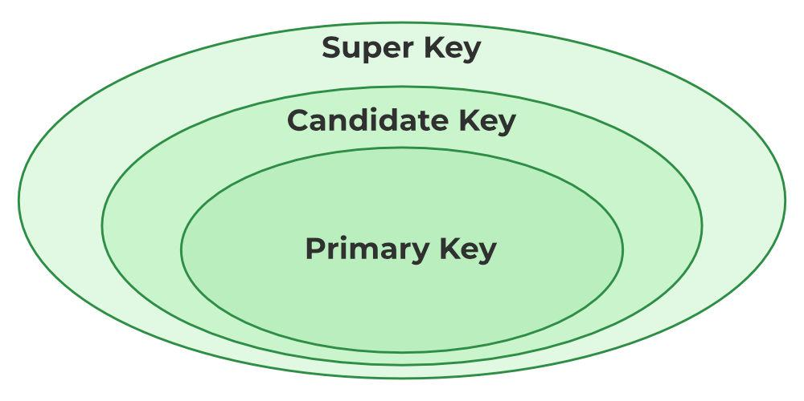
A super key could be a combination of STUD_NO and PHONE, as this combination uniquely identifies a student.

Slide 7
2. Candidate Key
The minimal set of attributes that can uniquely identify a tuple is known as a candidate key. For Example, STUD_NO in STUDENT relation.
A candidate key is a minimal super key, meaning it can uniquely identify a record but contains no extra attributes.
It is a super key with no repeated data is called a candidate key.
The minimal set of attributes that can uniquely identify a record.
A candidate key must contain unique values, ensuring that no two rows have the same value in the candidate key’s columns.
Every table must have at least a single candidate key.
A table can have multiple candidate keys but only one primary key.

Slide 8
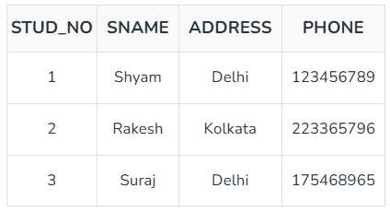
Example: For the STUDENT table below, STUD_NO can be a candidate key, as it uniquely identifies each record.

Slide 9

Table: STUDENT_COURSE
A composite candidate key example: {STUD_NO, COURSE_NO} can be a candidate key for a STUDENT_COURSE table.NT_COURSE

Slide 10
3. Primary Key
There can be more than one candidate key in relation out of which one can be chosen as the primary key. For Example, STUD_NO, as well as STUD_PHONE, are candidate keys for relation STUDENT but STUD_NO can be chosen as the Primary Key(only one out of many candidate keys).
A primary key is a unique key, meaning it can uniquely identify each record (tuple) in a table.It must have unique values and cannot contain any duplicate values.
A primary key cannot be NULL, as it needs to provide a valid, unique identifier for every record.
A primary key does not have to consist of a single column. In some cases, a composite primary key (made of multiple columns) can be used to uniquely identify records in a table.Databases typically store rows ordered in memory according to primary key for fast access of records using primary key.

Slide 11
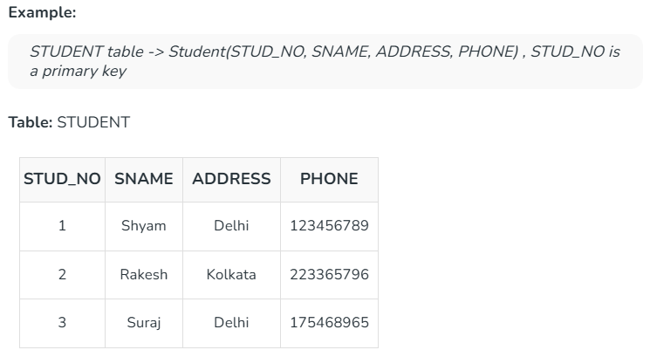

Slide 12
4. Alternate Key
An Alternate Key is any candidate key in a table that is not chosen as the primary key. In other words, all the keys that are not selected as the primary key are considered alternate keys.
An alternate key is also referred to as a secondary key because it can uniquely identify records in a table, just like the primary key.
An alternate key can consist of one or more columns (fields) that can uniquely identify a record, but it is not the primary key.

Slide 13
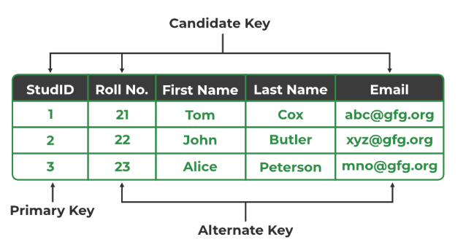
Example: In the STUDENT table, both STUD_NO and PHONE are candidate keys. If STUD_NO is chosen as the primary key, then PHONE would be considered an alternate key.

Slide 14
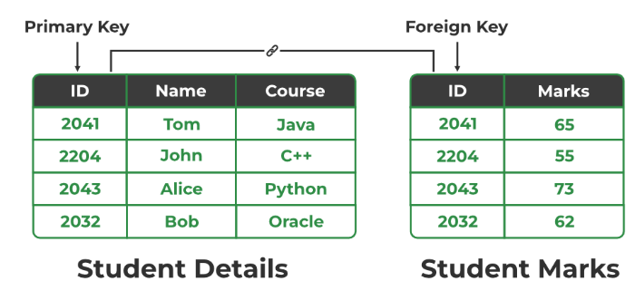
5. Foreign Key
A Foreign Key is an attribute in one table that refers to the primary key in another table. The table that contains the foreign key is called the referencing table and the table that is referenced is called the referenced table.

Slide 15
A foreign key in one table points to the primary key in another table, establishing a relationship between them.
It helps connect two or more tables, enabling you to create relationships between them. This is important for maintaining data integrity and preventing data redundancy.
They act as a cross-reference between the tables.

Slide 16

Example: Consider the STUDENT_COURSE table.

Slide 17
Explanation:
Here, STUD_NO in the STUDENT_COURSE table is a foreign key that references the STUD_NO primary key in the STUDENT table.
Unlike the Primary Key of any given relation, Foreign Key can be NULL as well as may contain duplicate tuples i.e. it need not follow uniqueness constraint. For Example, STUD_NO in the STUDENT_COURSE relation is not unique.
It has been repeated for the first and third tuples. However, the STUD_NO in STUDENT relation is a primary key and it needs to be always unique and it cannot be null.

Slide 18
6. Composite Key
Sometimes, a table might not have a single column/attribute that uniquely identifies all the records of a table. To uniquely identify rows of a table, a combination of two or more columns/attributes can be used. It still can give duplicate values in rare cases. So, we need to find the optimal set of attributes that can uniquely identify rows in a table.
It acts as a primary key if there is no primary key in a table
Two or more attributes are used together to make a Composite Key.
Different combinations of attributes may give different accuracy in terms of identifying the rows uniquely.

Slide 19
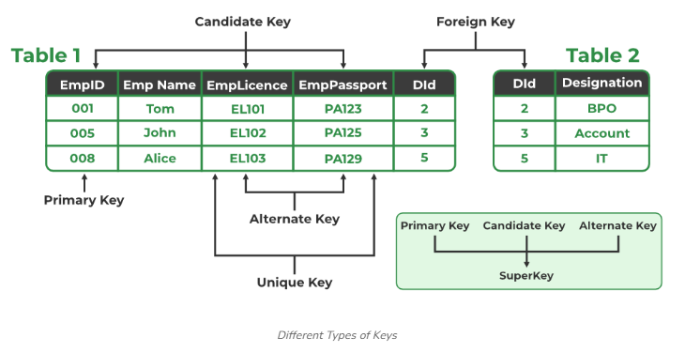
Example: In the STUDENT_COURSE table, {STUD_NO, COURSE_NO} can form a composite key to uniquely identify each record.

Slide 20
SQL constraints are essential elements in relational database design that ensure the integrity, accuracy, and reliability of the data stored in a database.
By enforcing specific rules on table columns, SQL constraints help maintain data consistency, preventing invalid data entries and optimizing query performance.
In this article, we will explain the most common SQL constraints in detail, providing clear examples and explaining how to implement them effectively.

Slide 21
What Are SQL Constraints?
SQL constraints are rules applied to columns or tables in a relational database to limit the type of data that can be inserted, updated, or deleted.
These rules ensure the data is valid, consistent, and adheres to the business logic or database requirements.
Constraints can be enforced during table creation or later using the ALTER TABLE statement. They play a vital role in maintaining the quality and integrity of your database.

Slide 22
Types of SQL Constraints
SQL provides several types of constraints to manage different aspects of data integrity.
These constraints are essential for ensuring that data meets the requirements of accuracy, consistency, and validity. Let’s go through each of them with detailed explanations and examples.
1. NOT NULL Constraint
2. UNIQUE Constraint
3. PRIMARY KEY Constraint
4. FOREIGN KEY Constraint
5. CHECK Constraint
6. DEFAULT Constraint

Slide 23
How to Specify Constraints in SQL
Constraints can be specified during the table creation process using the CREATE TABLE statement. Additionally, constraints can be modified or added to existing tables using the ALTER TABLE statement.
Syntax for Creating Constraints:
CREATE TABLE table_name
(
column1 data_type [constraint_name],
column2 data_type [constraint_name],
column3 data_type [constraint_name], ...
);
We can also add or remove constraints after a table is created.

Slide 24
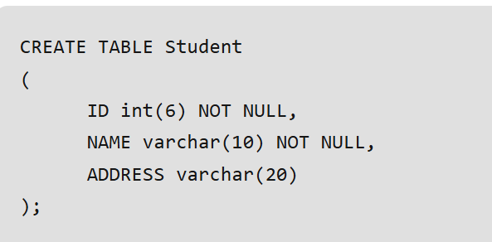
1. NOT NULL Constraint
The NOT NULL constraint ensures that a column cannot contain NULL values. This is particularly important for columns where a value is essential for identifying records or performing calculations. If a column is defined as NOT NULL, every row must include a value for that column.
Explanation: In the above example, both the ID and NAME columns are defined with the NOT NULL constraint, meaning every student must have an ID and NAME value.

Slide 25
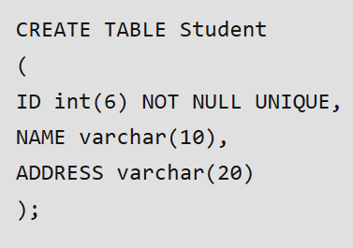
2. UNIQUE Constraint
The UNIQUE constraint ensures that all values in a column are distinct across all rows in a table. Unlike the PRIMARY KEY, which requires uniqueness and does not allow NULLs, the UNIQUE constraint allows NULL values but still enforces uniqueness for non-NULL entries.
Explanation: Here, the ID column must have unique values, ensuring that no two students can share the same ID. We can have more than one UNIQUE constraint in a table.

Slide 26
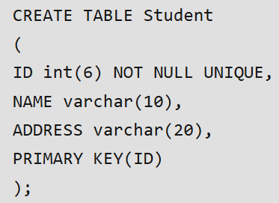
3. PRIMARY KEY Constraint
A PRIMARY KEY constraint is a combination of the NOT NULL and UNIQUE constraints. It uniquely identifies each row in a table. A table can only have one primary Key and it cannot accept NULL values. This is typically used for the column that will serve as the identifier of records.
Explanation: In this case, the ID column is set as the primary key, ensuring that each student’s ID is unique and cannot be NULL.

Slide 27
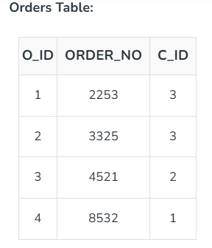
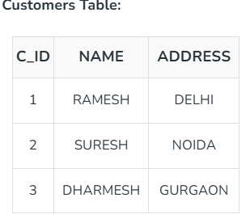
4. FOREIGN KEY Constraint
A FOREIGN KEY constraint links a column in one table to the primary key in another table. This relationship helps maintain referential integrity by ensuring that the value in the foreign key column matches a valid record in the referenced table.

Slide 28
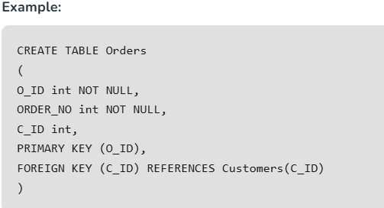
As we can see clearly that the field C_ID in Orders table is the primary key in Customers table, i.e. it uniquely identifies each row in the Customers table. Therefore, it is a Foreign Key in Orders table.
Explanation: In this example, the C_ID column in the Orders table is a foreign key that references the C_ID column in the Customers table. This ensures that only valid customer IDs can be inserted into the Orders table.

Slide 29
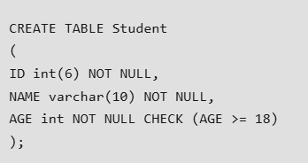
5. CHECK Constraint
The CHECK constraint allows us to specify a condition that data must satisfy before it is inserted into the table. This can be used to enforce rules, such as ensuring that a column’s value meets certain criteria (e.g., age must be greater than 18).
Explanation: In the above table, the CHECK constraint ensures that only students aged 18 or older can be inserted into the table.

Slide 30
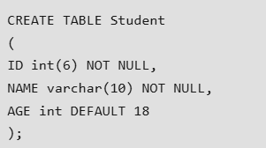
6. DEFAULT Constraint
The DEFAULT constraint provides a default value for a column when no value is specified during insertion. This is useful for ensuring that certain columns always have a meaningful value, even if the user does not provide one.
Explanation: Here, if no value is provided for AGE during an insert, the default value of 18 will be assigned automatically.

Slide 31
Thankyou

